Slide 1
HEALTH
APPLICATIONS
IN OUR LIFE

Slide 2
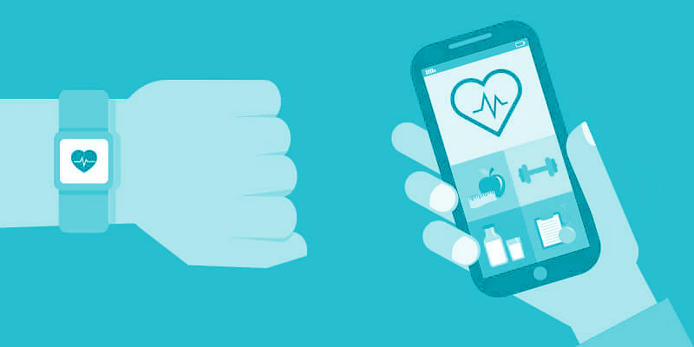
WHAT ARE EXACTLY THE HEALTH APPS?
Health apps keep all your health and fitness information under your control.
Mobile application programs that offer health-related services;

Slide 3
They...
Advice about fitness and nutrition;
Help doctors and patients communicate from afar;
Allow doctors to keep accurate records that are easily accessible.
WHAT DO THEY OFFER?

Slide 4
Inform;
Instruct;
Record;
Display;
Guide;
Remind/Alert;
Communicate.
HOW DO THEY HELP US VISIONING OUR HEALTH?

Slide 5
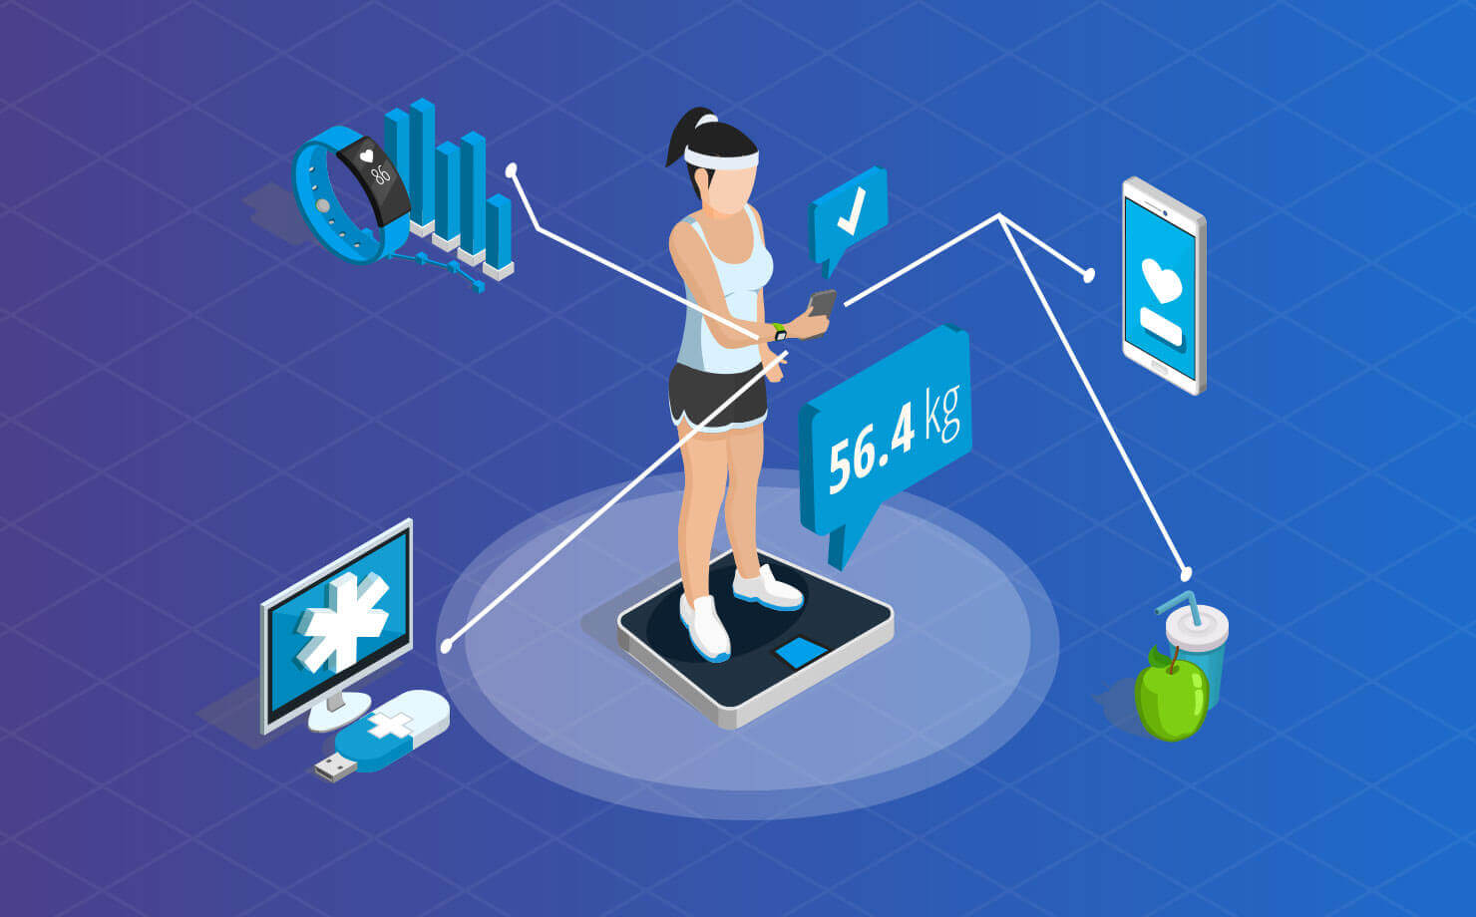
DO WE USE THEM ONLY FOR SPORTS?

Slide 6
WHICH BASIC HEALTH OR SPORT FACTOR CAN WE WATCH?
Living with cancer
Medication reminders
Nutrition
Fitness
Quitting smoking
Sleep
Stress

Slide 7
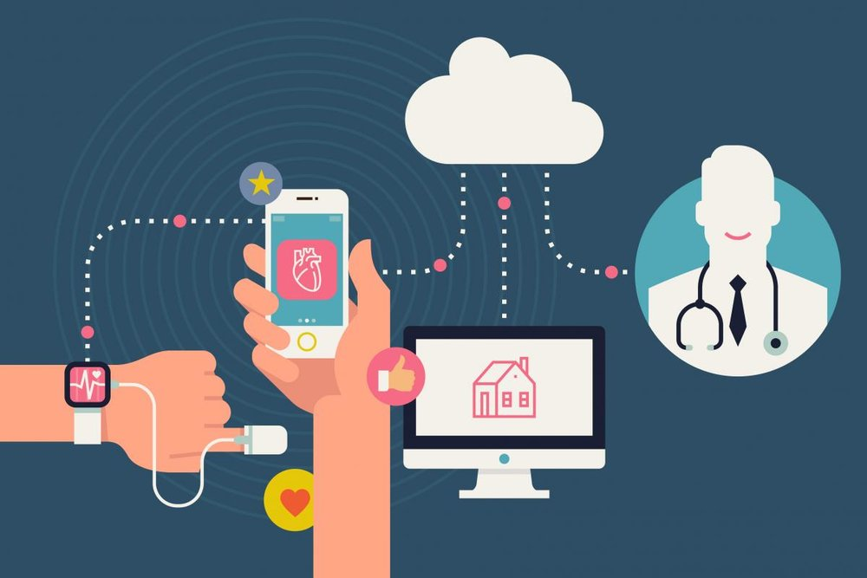
CAN THEY HELP US IN THE PANDEMIC PERIOD?
Some apps can provide useful mental support during lockdown;
The STAYAWAY COVID app is a tool that helps identify people exposed to coronavirus.

Slide 8
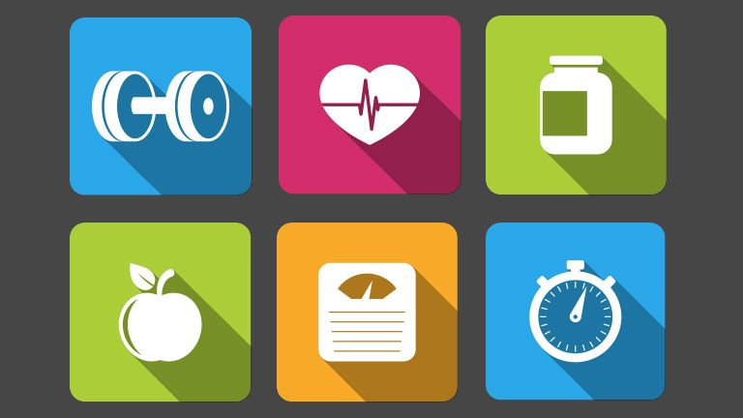
DO THEY ALWAYS HAVE A POSITIVE IMPACT ON US OR NOT?

Slide 9
ARE OUR PERSONAL DATA COLLECTION SAFE?
The vast majority of the apps are not reviewed or regulated by the US Food and Drug Administration;
What can be achieve with the user-generated health data relies on participants' willingness to share their data;
They all capture tons of personal data.

Slide 10
HEALTH
APPLICATIONS
IN OUR LIFE

